Slide 1

Voltage Glitching Intel Microcode
Federico Cerutti / ceres-c
Università degli Studi di Brescia
Previously: VU Amsterdam

Slide 2
TL;DR
What: Glitch Intel microcode
How: Voltage glitching
Why: Attack microcode update
Did it work? Kinda no?

Slide 3
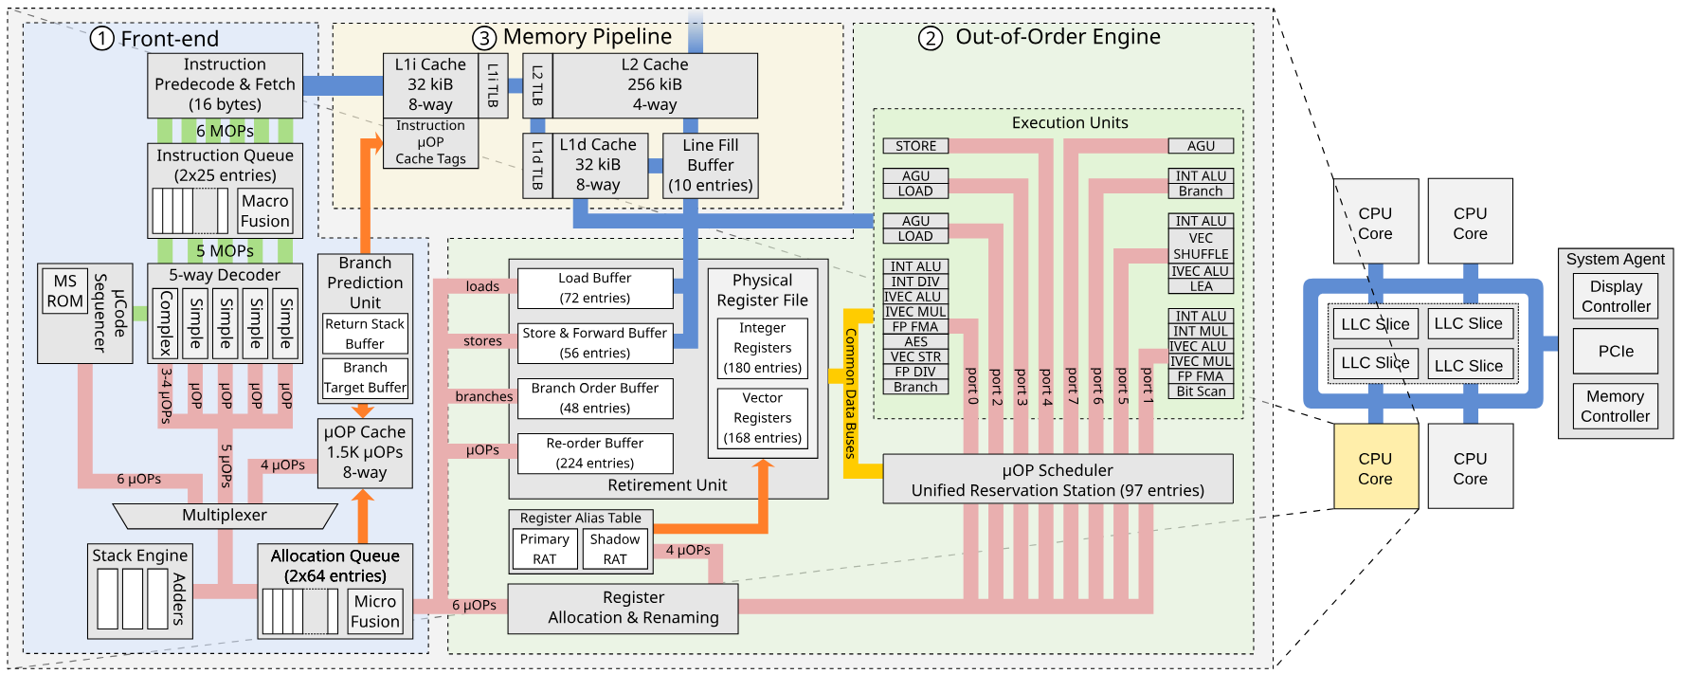
CPU 101
Custom Processing Unit: Tracing and Patching Intel Atom Microcode – Pietro Borrello, Martin Schwarzl
Notes:
Microcoded CPU! For performance

Slide 4
Arch → μArch instructions
Fetch
Decode queue
(Instruction fusion)
Decode:
Allocation queue
…
We pretend speculative execution does not exist
Simple decoder
Complex decoder
‌Microcode sequencer
1 x86 = 1 μ-op
1 x86 = 3/4 μ-op
1 x86 = n μ-op

Slide 5
Microcode Sequencer
Implements complex instructions
Does not execute code directly, however has:
ROM
RAM
Registers
Instruction pointer
Peripherals
Updatable
Signed updates

Slide 6
Previously on: Red Unlock
Intel products have extensive testing & debugging features
Can be activated via:
Hardware straps (preproduction only)
Efuses (disabled on non-dev)
JTAG password
Software

Slide 7
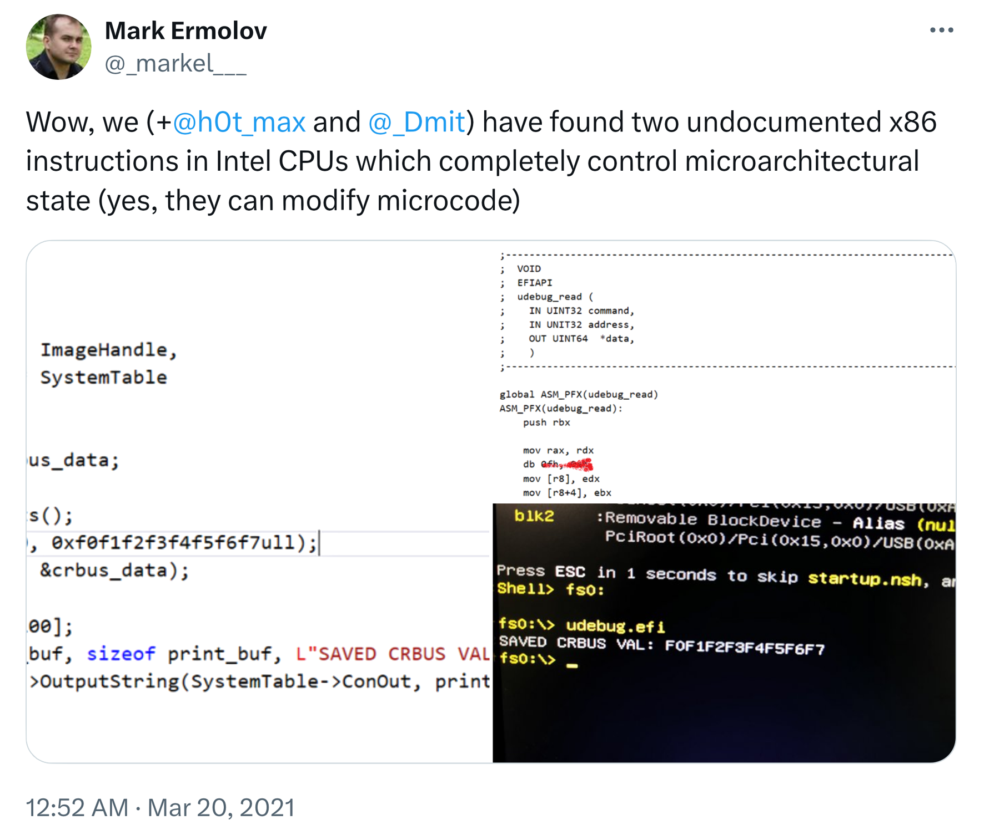

Previously on: Red Unlock
Ermolov, Goryachy and Sklyarov
Intel products have extensive testing & debugging features
Can be activated via:
Hardware straps (preproduction only)
Efuses (disabled on non-dev)
JTAG password
Software
Introducing: Intel ME exploits on Goldmont SoCs
Notes:
Ermolov, Goryachy and Sklyarov

Slide 8

Previously on: Red Unlock - Goldmont
Ermolov, Goryachy and Sklyarov
Exploit ME 11
Extract microcode with JTAG
Reverse engineer architecture
Find architectural instructions to read/write microarchitectural state
???
Write your own microcode!
CustomProcessingUnit¹
lib-micro²
1: https://github.com/pietroborrello/CustomProcessingUnit/
2: https://github.com/zanderdk/lib-micro/

Slide 9
Custom Microcode
MSROM
XLAT
rdrand
cpuid
vmenter
…

Slide 10
Custom Microcode
MSROM
XLAT
rdrand
cpuid
vmenter
…
MSRAM
match&patch

Slide 11



Previously on: x86 Voltage Glitching
Intel and AMD CPUs proven vulnerable to voltage fault injection
No changes to the power supply, leverage the PMIC¹
Two ways:
Software based: Plundervolt, VoltJockey
Hardware based: VoltPillager, PMFault
Glitch x86 or secure enclaves
1: Power Management Integrated Chip

Slide 12
Previously on: x86 Voltage Glitching
Intel and AMD CPUs proven vulnerable to voltage fault injection
No changes to the power supply, leverage the PMIC¹
Two ways:
Software based: Plundervolt, VoltJockey
Hardware based: VoltPillager, PMFault
Glitch x86 or secure enclaves
How about microcode?
1: Power Management Integrated Chip

Slide 13
Roadmap
Find hardware
Must be red unlocked
Possibly simple I/O
Build software setup
x86 convoluted bootstrap
Make it fast
How2microcode?
Port Plundervolt x86 results
Attack custom microprograms
Attack microcode update

Slide 14
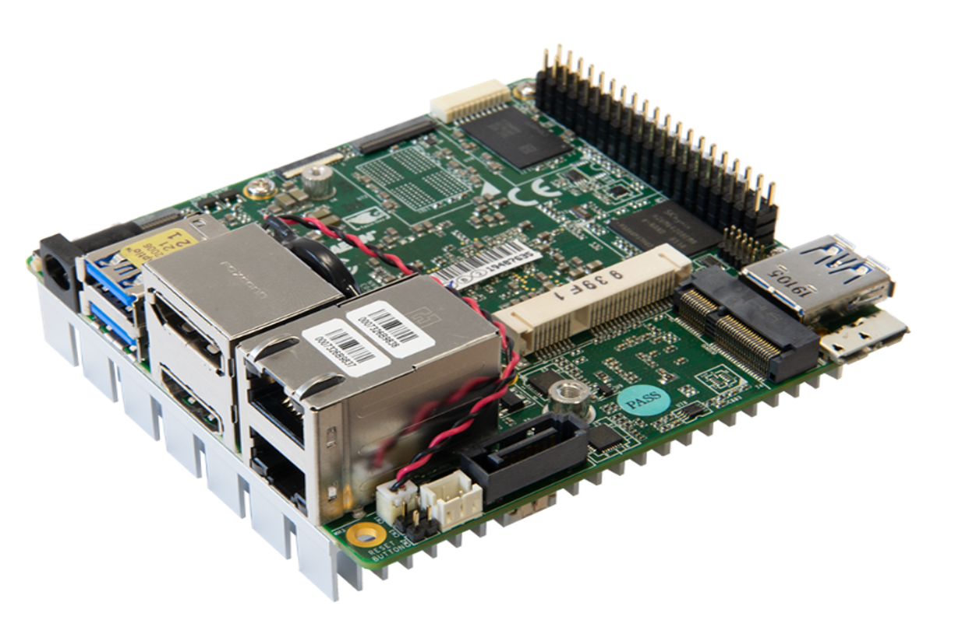
Pick (red unlocked) hardware
Gigabyte BRIX BPCE-3350C ¹
Up Squared ²
Intel Celeron N3350
AMI BIOS
Ermolov et al.
Intel Pentium N4200
coreboot
GPIO
lib-micro
1: https://github.com/ptresearch/IntelTXE-PoC
2: https://github.com/zanderdk/lib-micro/

Slide 15
Software
Issue | Solution
BIOS boot time w/ red unlock > 2min

Slide 16

Software
Issue | Solution
BIOS boot time w/ red unlock > 2min | Target code in coreboot

Slide 17
Software
Issue | Solution
BIOS boot time w/ red unlock > 2min | Target code in coreboot
coreboot (32-bit) vs. microcode libs (64-bit)

Slide 18
Software
Issue | Solution
BIOS boot time w/ red unlock > 2min | Target code in coreboot
coreboot (32-bit) vs. microcode libs (64-bit) | Port lib-micro

Slide 19
Software
Issue | Solution
BIOS boot time w/ red unlock > 2min | Target code in coreboot
coreboot (32-bit) vs. microcode libs (64-bit) | Port lib-micro
Custom microcode in early boot halts CPU

Slide 20
Software
Issue | Solution
BIOS boot time w/ red unlock > 2min | Target code in coreboot
coreboot (32-bit) vs. microcode libs (64-bit) | Port lib-micro
Custom microcode in early boot halts CPU | Find stable execution point
Memory
location
Cache-As-Ram
DRAM
coreboot
stage
bootblock
romstage
postCAR
ramstage
payload
~700 ms
target
Up Squared + coreboot is the way to go

Slide 21
Software
Issue | Solution
BIOS boot time w/ red unlock > 2min | Target code in coreboot
coreboot (32-bit) vs. microcode libs (64-bit) | Port lib-micro
Custom microcode in early boot halts CPU | Find stable execution point
(manually 🤡)
Memory
location
Cache-As-Ram
DRAM
coreboot
stage
bootblock
romstage
postCAR
ramstage
payload
~700 ms
target
Up Squared + coreboot is the way to go

Slide 22
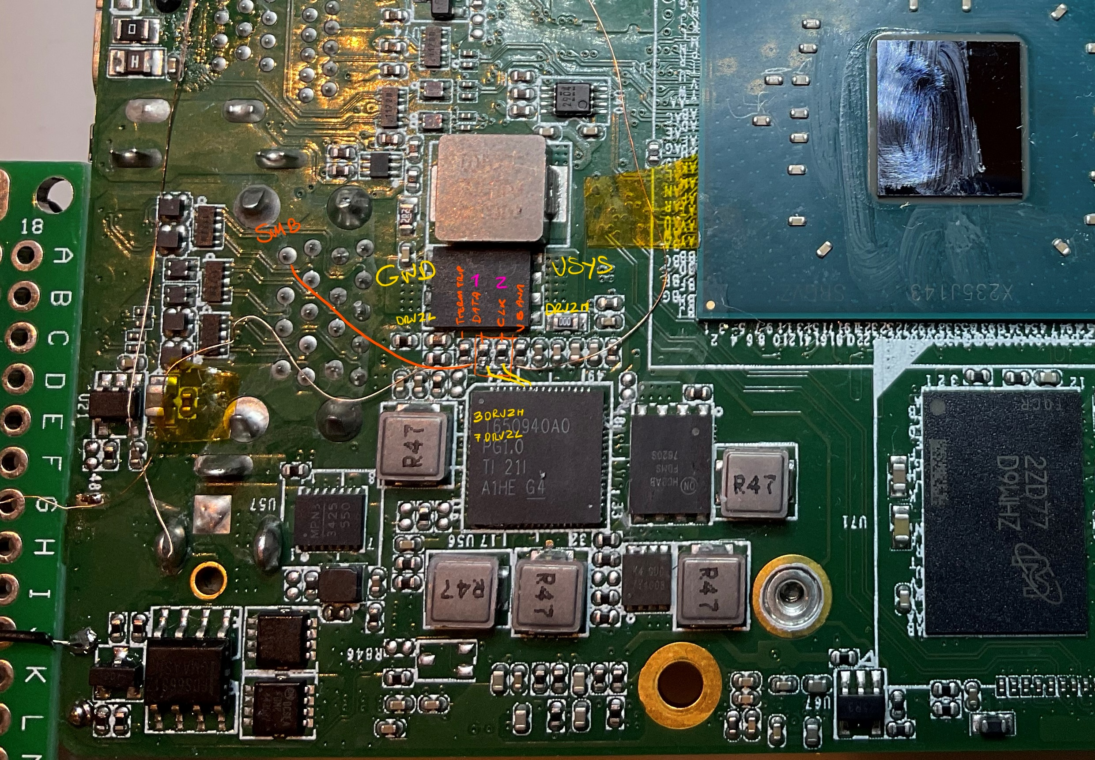
Inject the glitch
Control the PMIC:
Software
Hardware
Bonus: find VCore
Thanks to Carlo Maragno

Slide 23
Inject the glitch
Control the PMIC:
​Software
Hardware
Bonus: find VCore
Thanks to Carlo Maragno

Slide 24
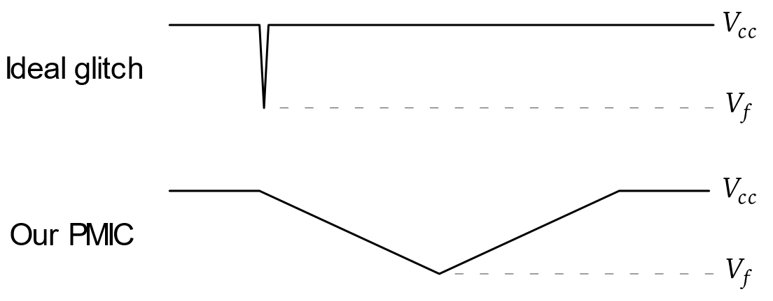
Interjection: Glitch characteristics
1: Inspired by VoltPillager

Slide 25
Interjection: Glitch characteristics
1: Inspired by VoltPillager

Slide 26
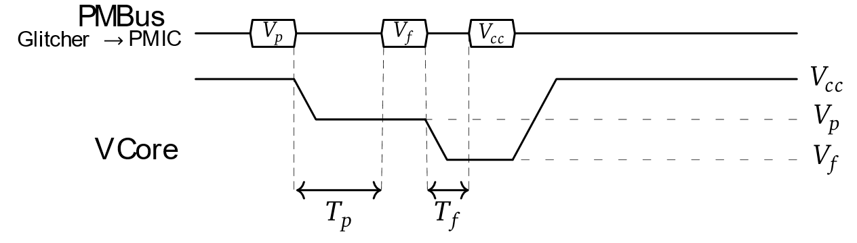
Interjection: Glitch characteristics
A two-stage glitch¹
1: Inspired by VoltPillager

Slide 27
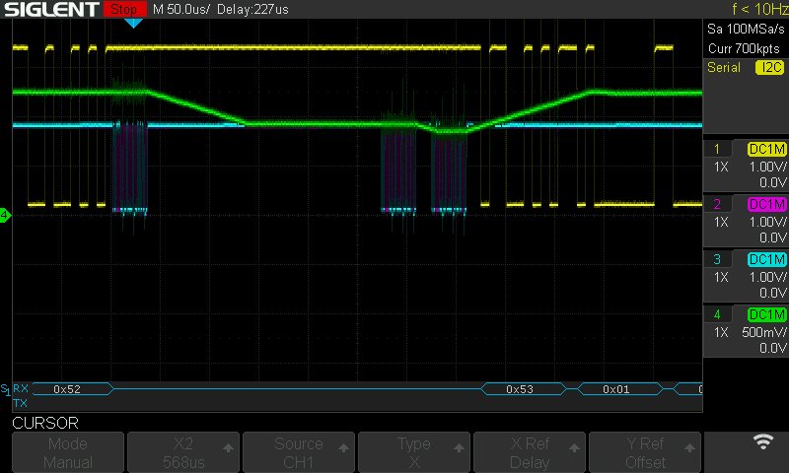
Slow PMIC - Workaround
A two-stage glitch¹
1: Inspired by VoltPillager

Slide 28
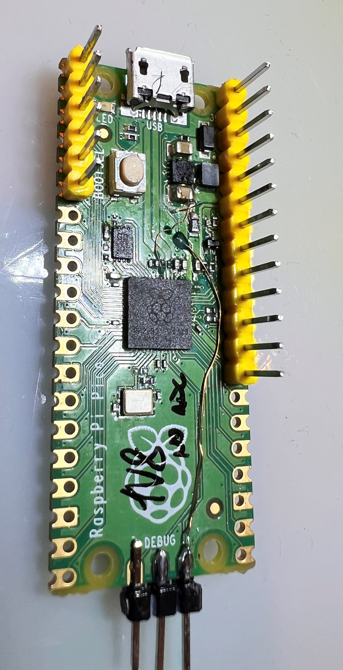
Injecting the glitch
Raspberry Pi Pico FTW
GPIO @ 3v3 :(
Modify Pi Pico
IOVDD @ 1v8
USB_VDD @ 3v3
Swap SPI flash

Slide 29
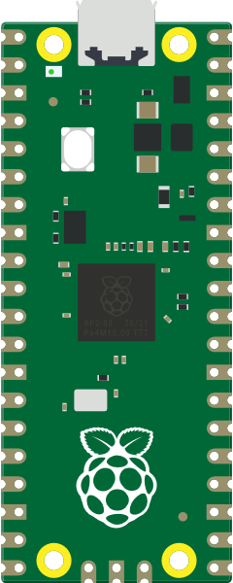
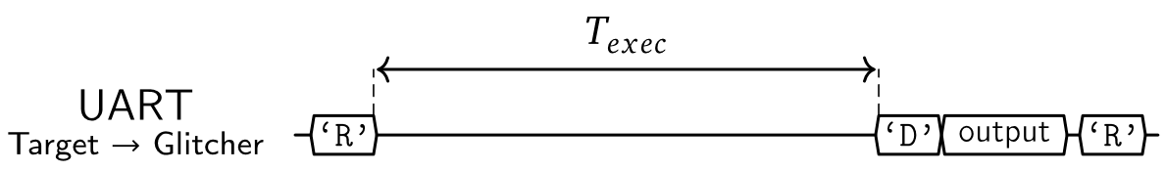
Getting them to talk
GPIO? Not really
CPLD proxy
UART will do!
Up Squared
UART
PMBus
Glitcher

Slide 30
Setup overview
5 components:
Target: Up Squared board
Glitcher: Raspberry Pi Pico
Host PC
Power supply
Oscilloscope
Host
USB
USB
Up Squared
UART
5V
PMBus
Laboratory PSU
Glitcher
VCore probe
PMBus probe
Oscilloscope

Slide 31
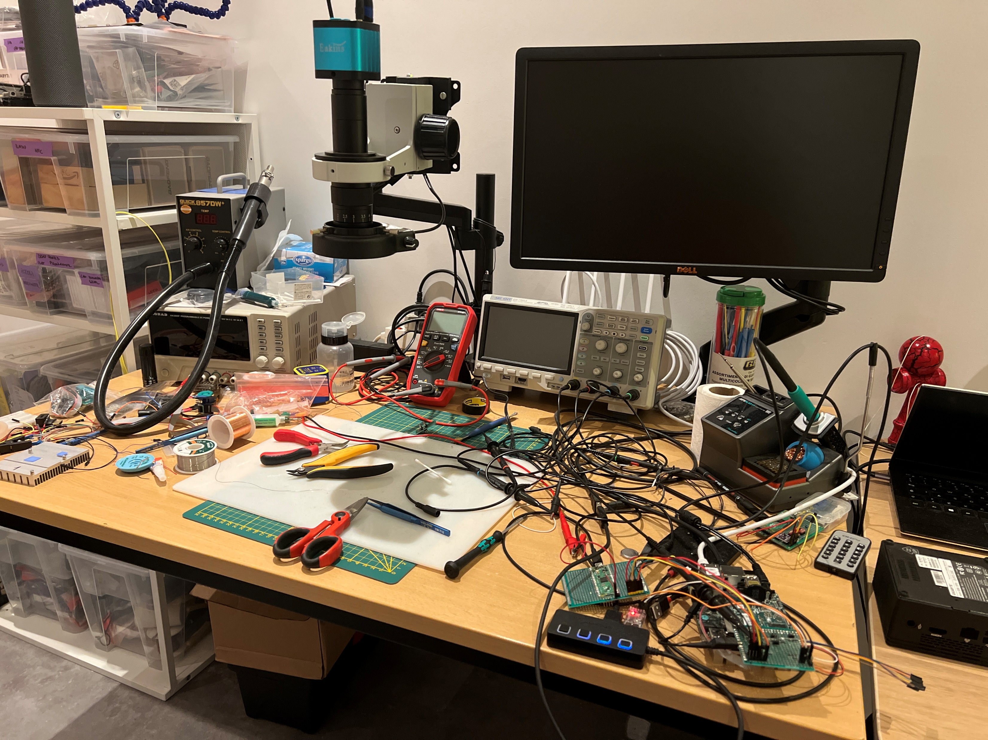
Setup overview
5 components:
Target: Up Squared board
Glitcher: Raspberry Pi Pico
Host PC
Power supply
Oscilloscope
Host
USB
USB
Up Squared
UART
5V
PMBus
Laboratory PSU
Glitcher
VCore probe
PMBus probe
Oscilloscope

Slide 32
Previous research: Plundervolt
Simple arithmetic operations can’t be glitched
ADD/SUB, OR/XOR/AND: nope
IMUL can be faulted with:
specific operands
specific operand order, e.g.
0x80000 * 0x4: Faulty
0x4 * 0x80000: Not faulty
0x80001 * 0x4: Not faulty

Slide 33
x86 assembly: IMUL
movl $0x80000, %eax;
movl $0x4, %ebx;
movl %eax, %edx;
imull %ebx, %edx; # edx = 0x4*0x80000
movl %eax, %edi;
imull %ebx, %edi; # edi = 0x4*0x80000
cmp %edx, %edi;
setne %dl;
addb %dl, %cl;
Prepare operands
Multiply (twice)
Compare
Set dl[7:0] if different
Add dl[7:0] to cl[7:0]
Normal: ecx = 0 Fault: ecx > 0
AT&T syntax because coreboot

Slide 34
x86 assembly: IMUL
✔️
movl $0x80000, %eax;
movl $0x4, %ebx;
movl %eax, %edx;
imull %ebx, %edx; # edx = 0x4*0x80000
movl %eax, %edi;
imull %ebx, %edi; # edi = 0x4*0x80000
cmp %edx, %edi;
setne %dl;
addb %dl, %cl;
IMUL can be glitched!

Slide 35
x86 assembly: IMUL
❔
movl $0x80000, %eax;
movl $0x4, %ebx;
movl %eax, %edx;
imull %ebx, %edx; # edx = 0x4*0x80000
movl %eax, %edi;
imull %ebx, %edi; # edi = 0x4*0x80000
cmp %edx, %edi;
setne %dl;
addb %dl, %cl;
IMUL can be glitched:
Regardless of operand order
0x80000 * 0x4: Faulty
0x4 * 0x80000: Faulty

Slide 36
x86 assembly: IMUL
❔
movl $0x80000, %eax;
movl $0x4, %ebx;
movl %eax, %edx;
imull %ebx, %edx; # edx = 0x4*0x80000
movl %eax, %edi;
imull %ebx, %edi; # edi = 0x4*0x80000
cmp %edx, %edi;
setne %dl;
addb %dl, %cl;
IMUL can be glitched:
Regardless of operand order
0x80000 * 0x4: Faulty
0x4 * 0x80000: Faulty
Is it CMP?

Slide 37
x86 assembly: IMUL
❔
movl $0x80000, %eax;
movl $0x4, %ebx;
movl %eax, %edx;
imull %ebx, %edx; # edx = 0x4*0x80000
movl %eax, %edi;
imull %ebx, %edi; # edi = 0x4*0x80000
cmp %edx, %edi;
setne %dl;
addb %dl, %cl;
IMUL can be glitched:
Regardless of operand order
0x80000 * 0x4: Faulty
0x4 * 0x80000: Faulty
Is it CMP?
Sometimes
ecx = 0x200000

Slide 38
x86 assembly: IMUL
❔
movl $0x80000, %eax;
movl $0x4, %ebx;
movl %eax, %edx;
imull %ebx, %edx; # edx = 0x4*0x80000
movl %eax, %edi;
imull %ebx, %edi; # edi = 0x4*0x80000
cmp %edx, %edi;
setne %dl;
addb %dl, %cl;
IMUL can be glitched:
Regardless of operand order
0x80000 * 0x4: Faulty
0x4 * 0x80000: Faulty
Is it CMP?
Sometimes
ecx = 0x200000 (0x4*0x80000)
Is ADDB adding 32 bits?
Register file issues?

Slide 39
x86 assembly: CMP
movl $0xAAAAAAAA, %eax;
movl $0xAAAAAAAA, %ebx;
cmp %eax, %ebx;
setne %dl;
addb %dl, %cl;
Prepare operands
Compare
Set dl[7:0] if different
Add dl[7:0] to cl[7:0]
Normal: ecx = 0 Fault: ecx > 0

Slide 40
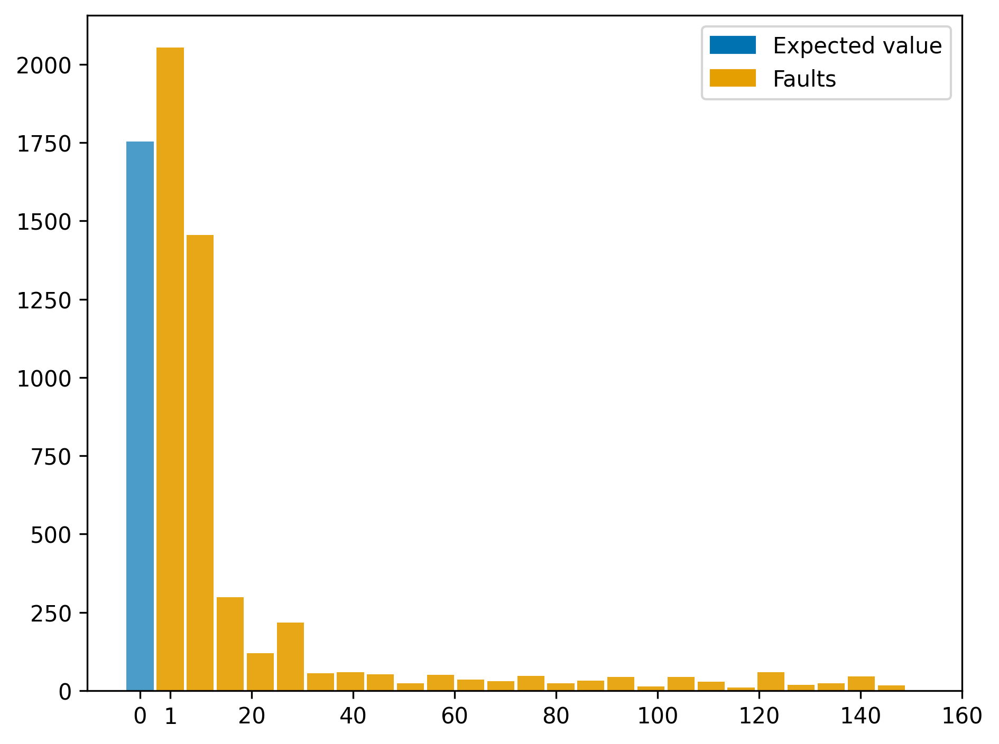
x86 assembly: CMP
✔️
movl $0xAAAAAAAA, %eax;
movl $0xAAAAAAAA, %ebx;
cmp %eax, %ebx;
setne %dl;
addb %dl, %cl;
Occurences
Fault count
Yup, CMP can be glitched 75% of the times

Slide 41
x86 assembly: Register file
mov $0x0101, %eax;
movb %al, %bl;
add %ebx, %ecx;
Prepare operand
Move al[7:0] to bl[7:0]
Add ebx[31:0] to ecx[31:0]
Normal: ecx = i Fault: ecx > i
(i iterations)
Notes:
Test:
Operations on sub-registers
Register rename

Slide 42
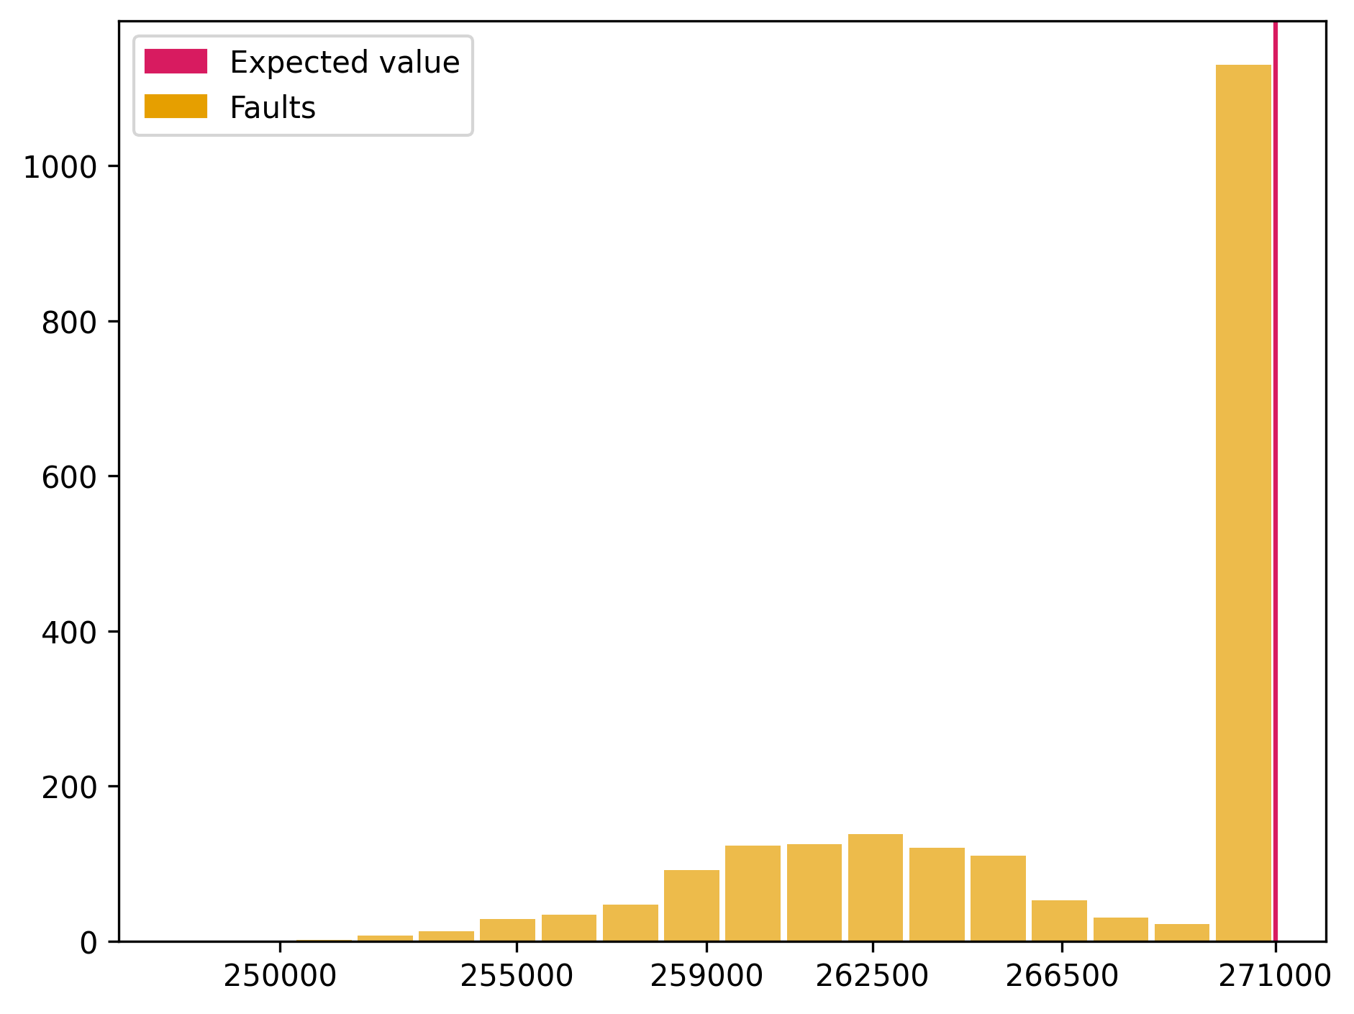
x86 assembly: Register file
❔
mov $0x0101, %eax;
movb %al, %bl;
add %ebx, %ecx;
Occurences
Return value
Probably not register file, but instructions skip

Slide 43
Custom microcode: ADDs
Replace RDRAND
{
ADD_DSZ64_DRI(RCX, RCX, 1),
ADD_DSZ64_DRI(RCX, RCX, 1),
ADD_DSZ64_DRI(RCX, RCX, 1),
NOP_SEQWORD
}, /* ... */ {
ADD_DSZ64_DRI(RCX, RCX, 1),
NOP,
NOP,
END_SEQWORD
},
Add 1 to ecx, 10 times in a row
Normal: ecx = i*10
(i iterations)
Arch fault: ecx % 10 = 0
μarch fault: ecx % 10 ≠ 0

Slide 44
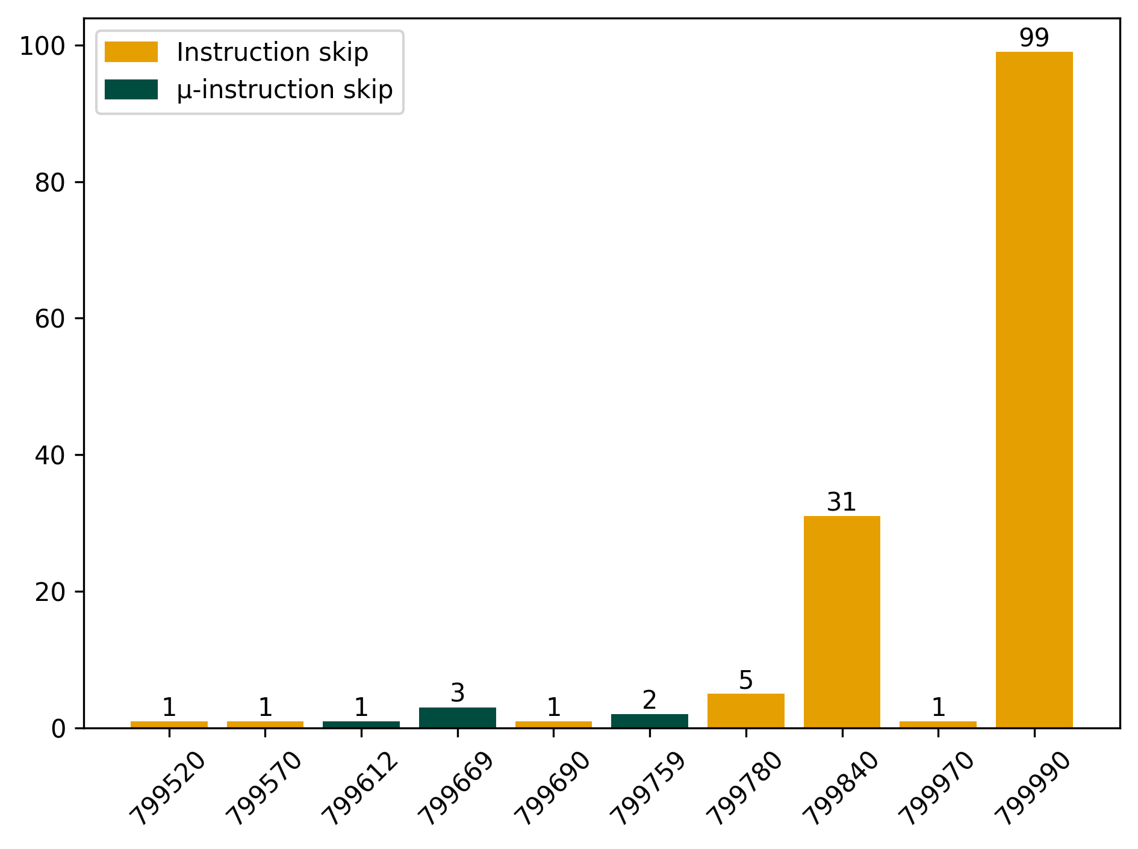
Custom microcode: ADDs
✔️
Replace RDRAND
{
ADD_DSZ64_DRI(RCX, RCX, 1),
ADD_DSZ64_DRI(RCX, RCX, 1),
ADD_DSZ64_DRI(RCX, RCX, 1),
NOP_SEQWORD
}, /* ... */ {
ADD_DSZ64_DRI(RCX, RCX, 1),
NOP,
NOP,
END_SEQWORD
},
Occurences
Return value
Both x86 and microcode instruction skip

Slide 45
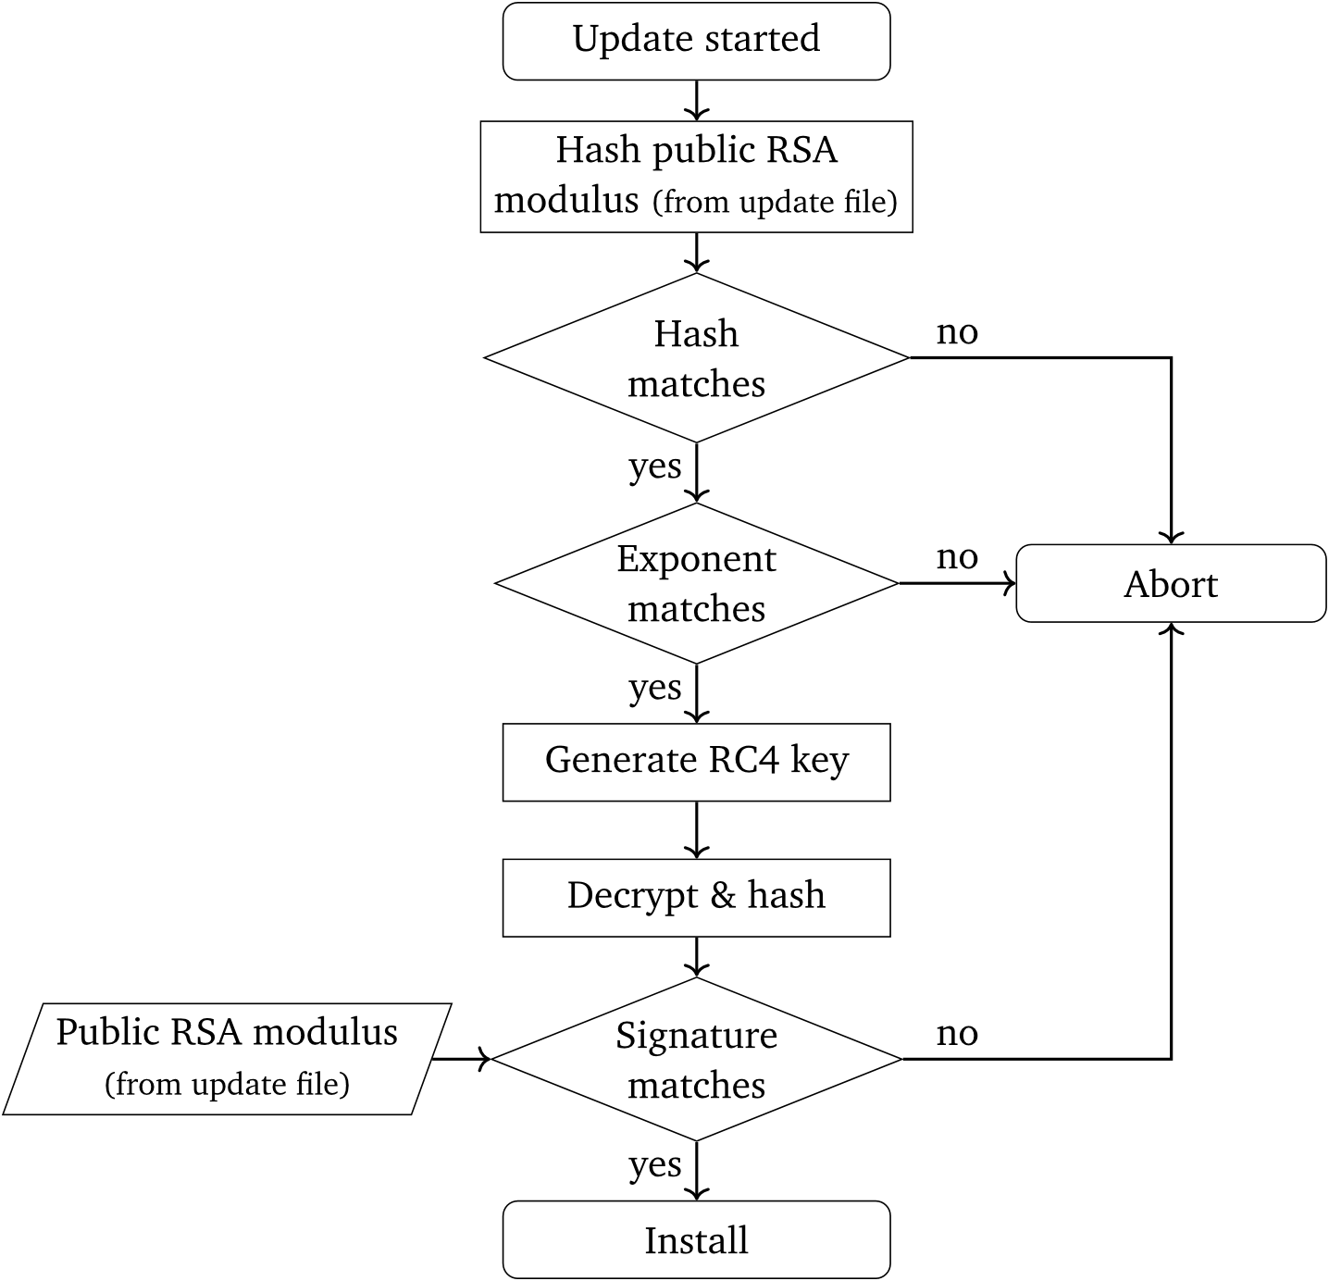
Previously on: Microcode updates
Documented in previous research
Treat it as a gray box
I hope it works like this
Secure (enough) cryptographic primitives

Slide 46
Previously on: Microcode updates
Documented in previous research
Treat it as a gray box
I hope it works like this
Secure (enough) cryptographic primitives
Can we attack these?

Slide 47
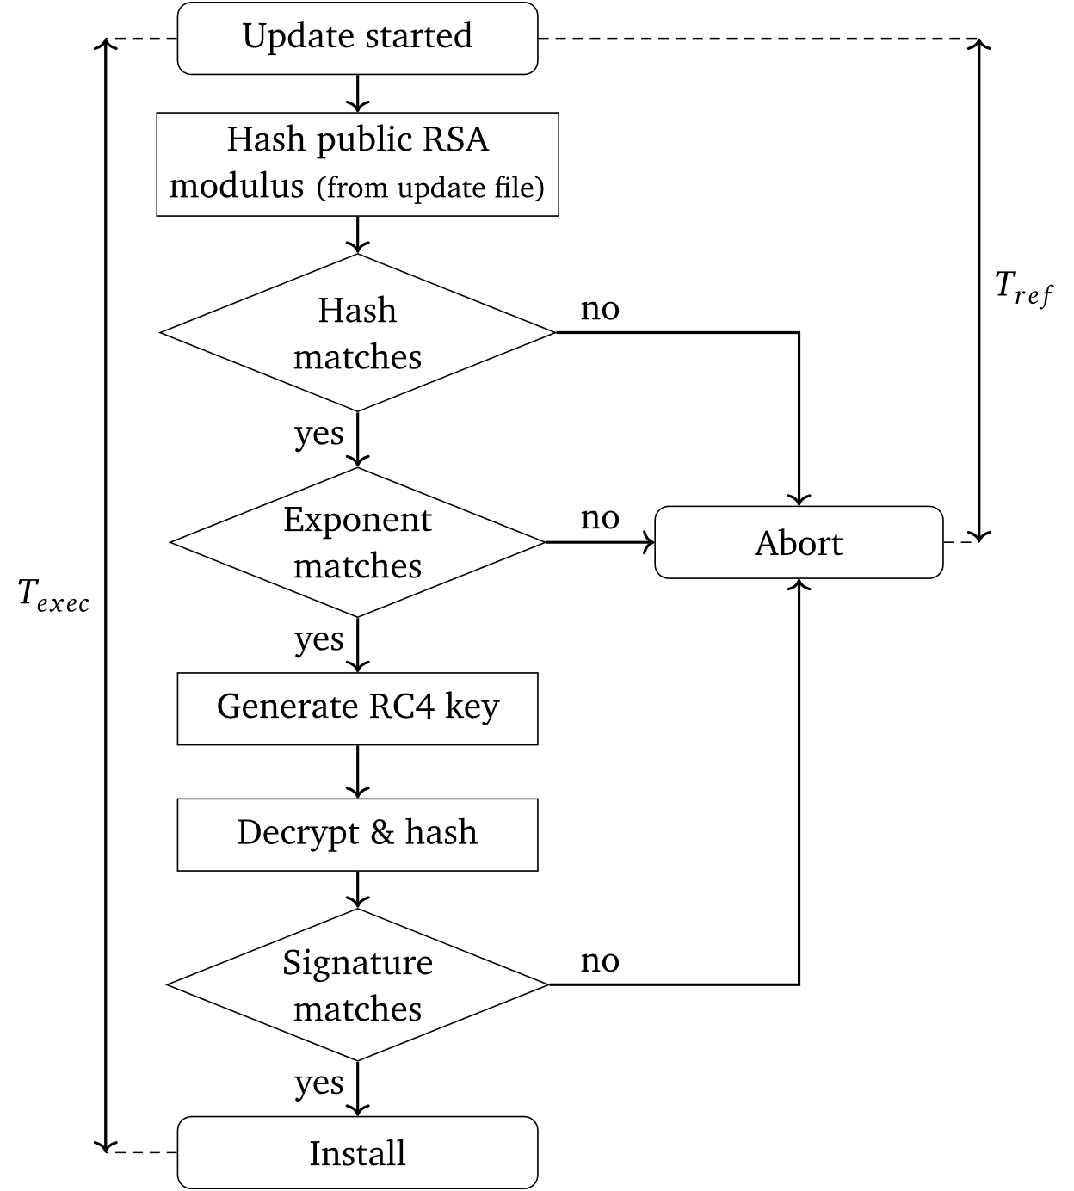
Microcode update: RSA modulus
Update is not constant-time
T_{exec} vs T_{ref}
Change signature
Apply update (fail)
Measure T_{ref} (fail)
Glitch
Normal: T_{exec} = T_{ref}
Fault: T_{exec} > T_{ref}

Slide 48
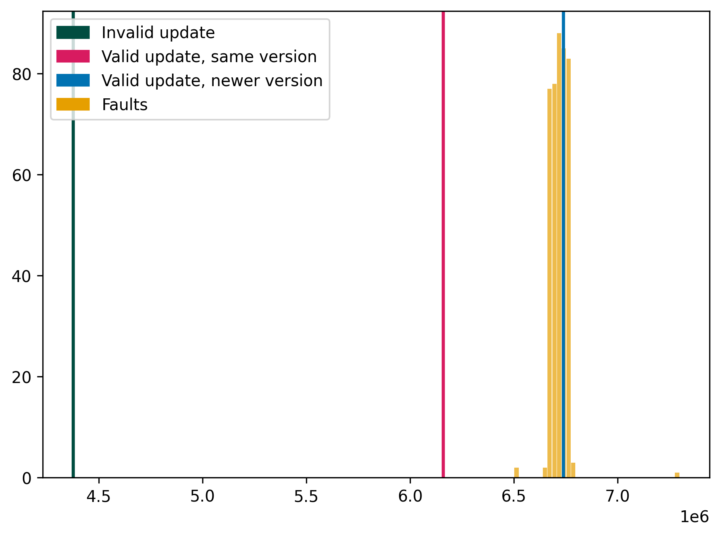
Microcode update: RSA modulus
❔
Occurences
T_{exec} (cycles)
Interesting timings :) Fail update :(

Slide 49
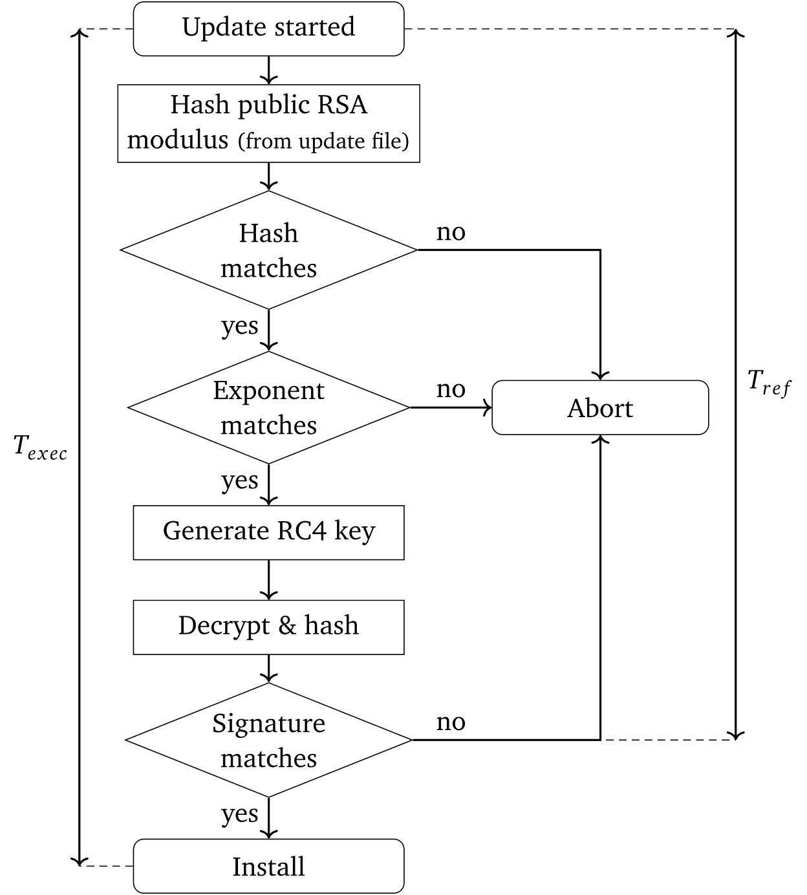
Microcode update: Signature
Update is not constant-time
T_{exec} vs T_{ref}
Change update content
Apply update (fail)
Measure T_{ref} (fail)
Glitch
Normal: T_{exec} = T_{ref}
Fault: T_{exec} > T_{ref}

Slide 50
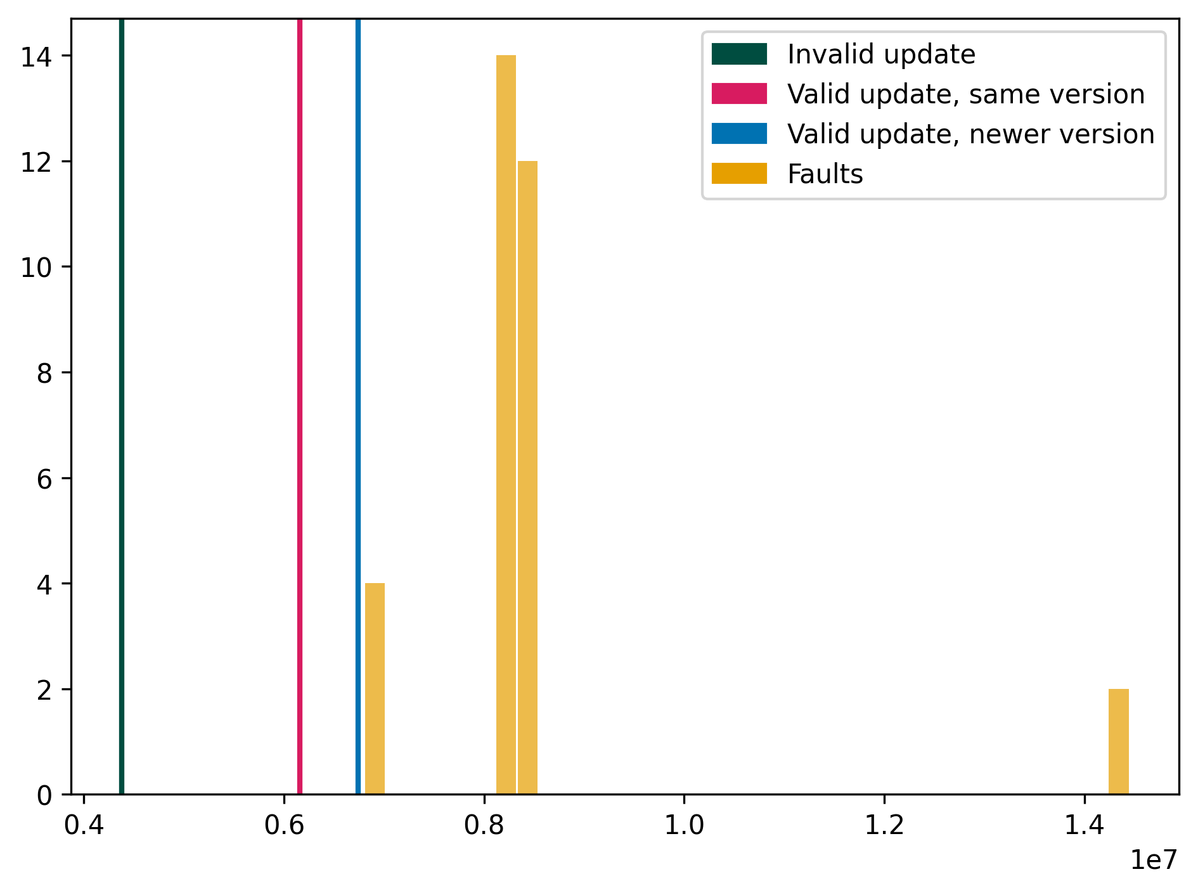
Microcode update: Signature
❌
Occurences
T_{exec} (cycles)
Meh timings :( Fail update :(

Slide 51
Recap
Unsigned microcode update rejected
Evidence of:
x86 arithmetic faults
x86 instruction skip
Register file weirdness
μ-instruction skip
Changed update program behavior
Future work:
Reverse engineer microcode update
Why glitch not enough?
Replace PMIC
TOCTOU RSA modulus?

Slide 52


Questions, remarks, vituperation?
https://github.com/ceres-c/VU-Thesis
federico@ceres-c.it
https://ceres-c.it/

Slide 53
Backup slides

Slide 54
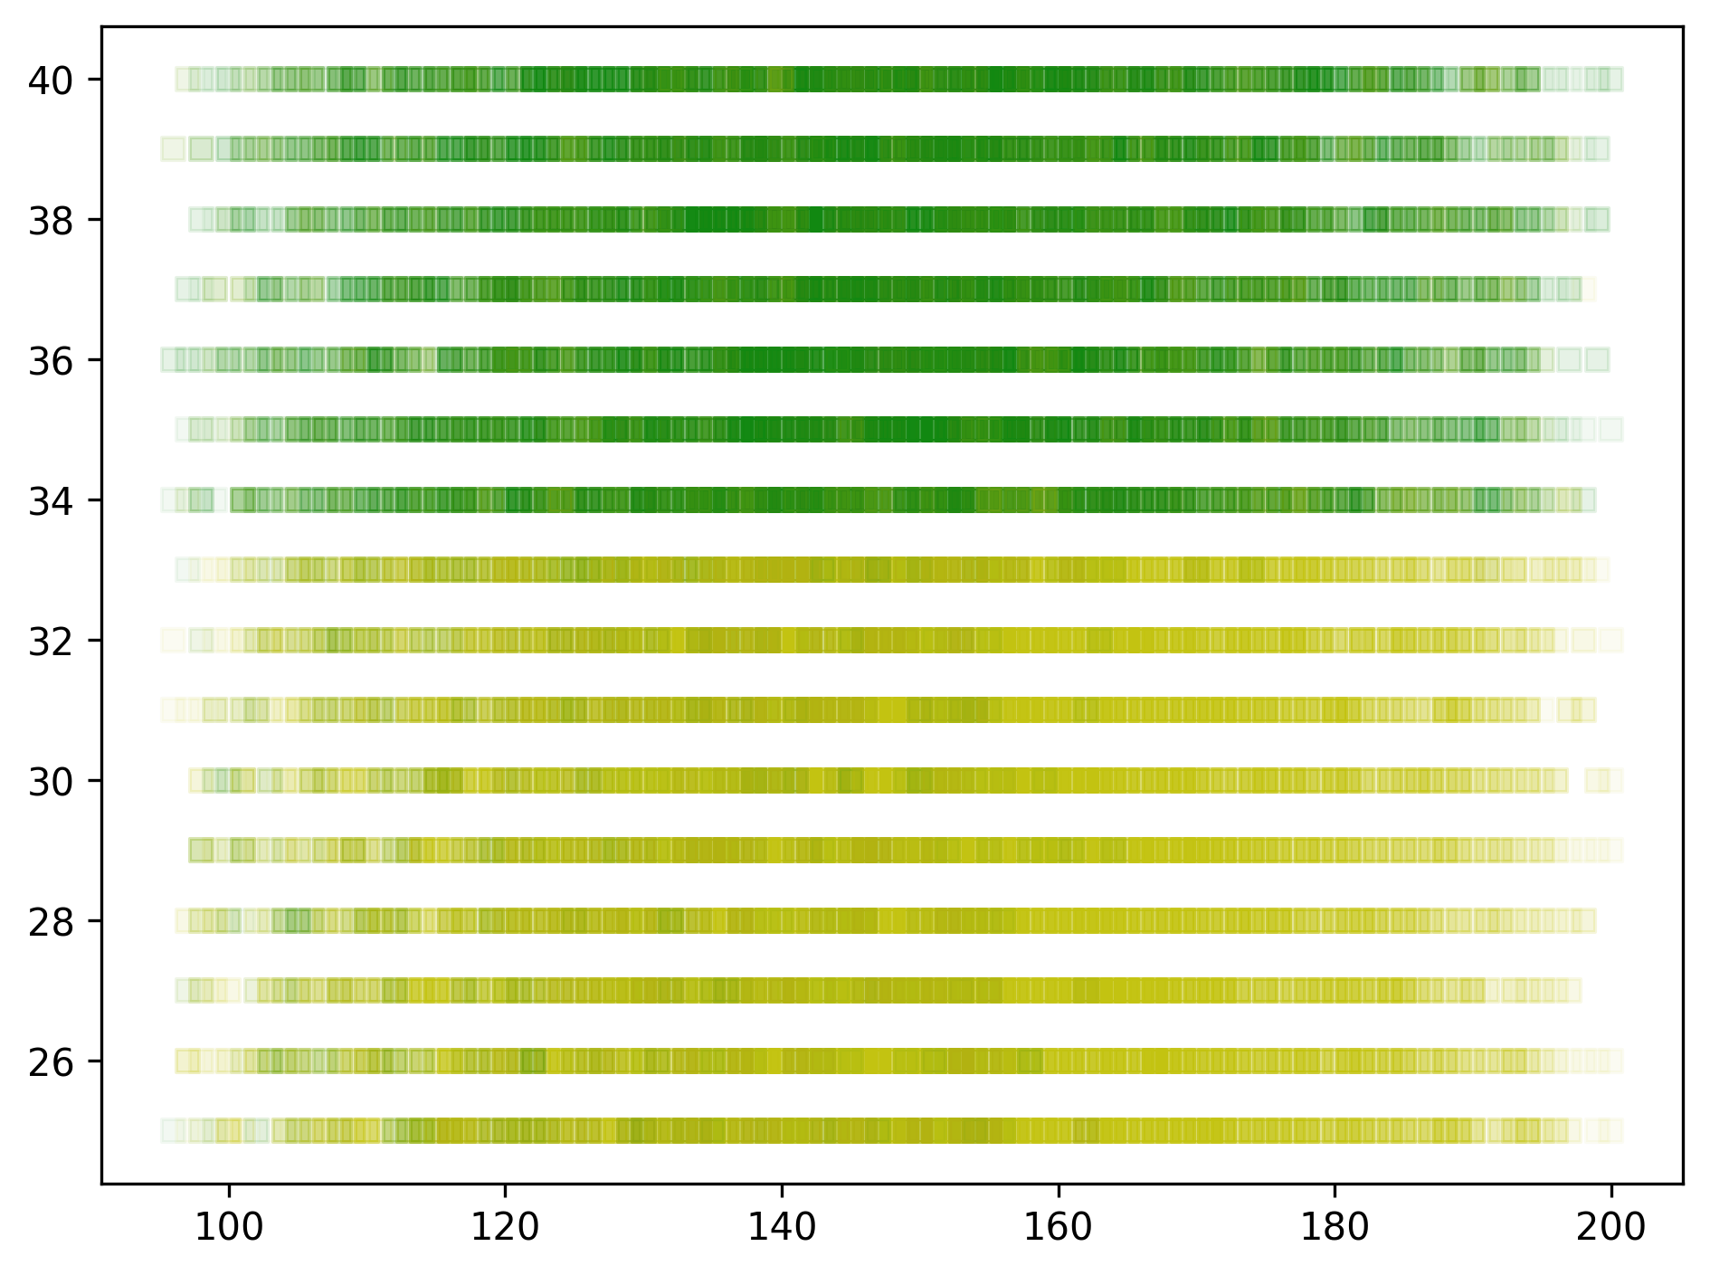
How to estimate voltages
Voltage (VID)
Time (μs)

Slide 55
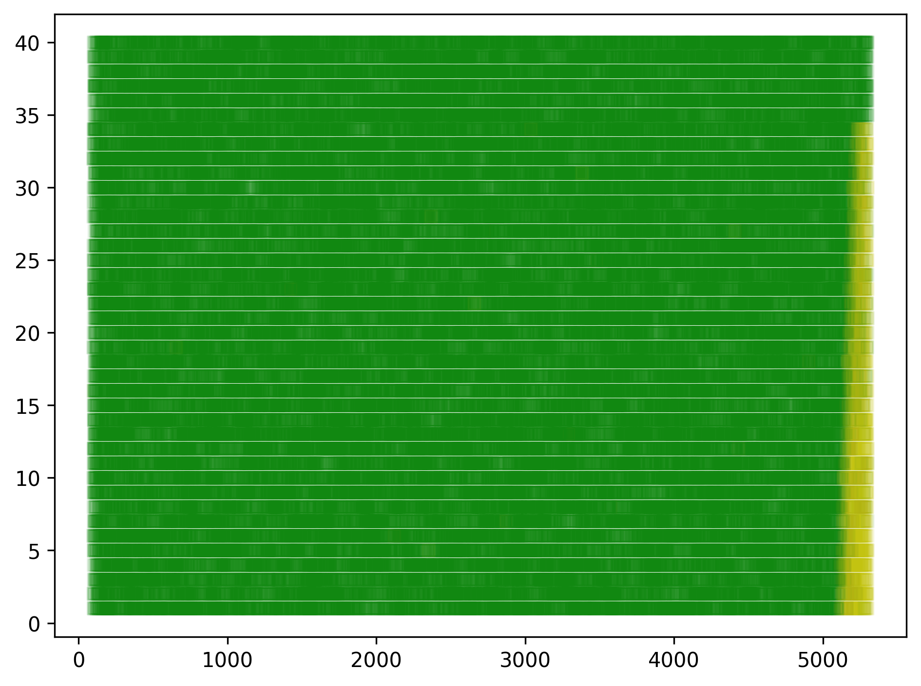
Signature check glitch fail
Voltage (VID)
Voltage (VID)
Time (μs)
Time (μs)
Notes:
Left: x86 code
Right: ucode (it never dies, there is no low voltage)

Slide 56
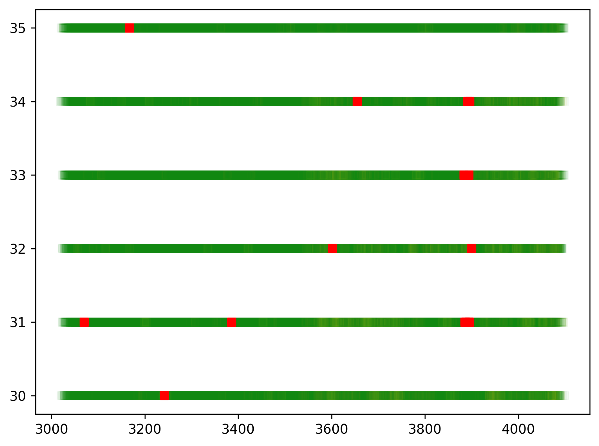
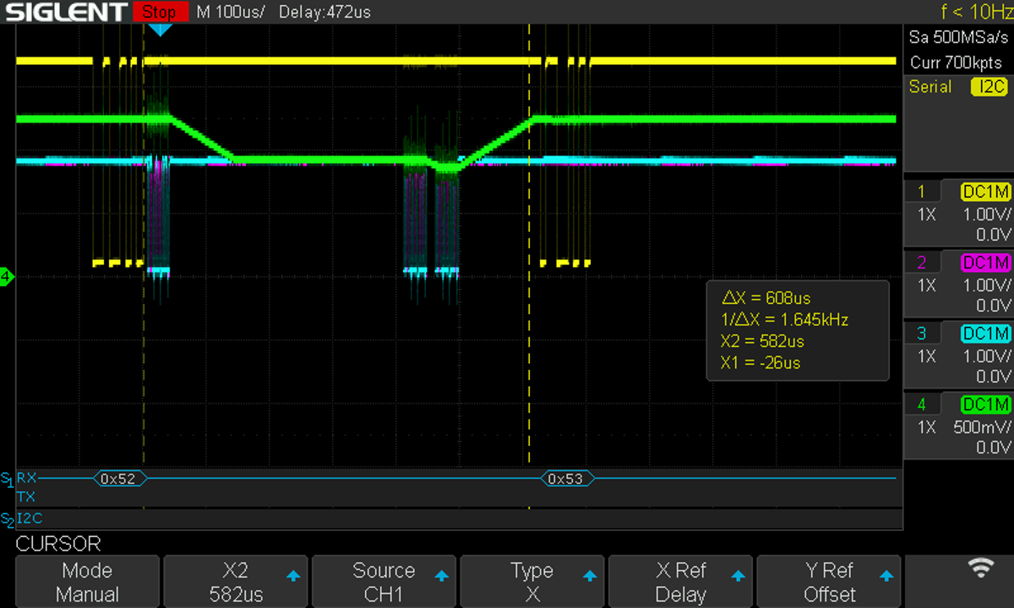
Signature check glitch fail
Voltage (VID)
Time (μs)
Notes:
Left: ucode glitches in
Right: example image where we can see the voltage does not rise fast enough
The voltages where we have successes in glitching the ucoda update are low. Too low to be reached near the end of the update

Slide 57
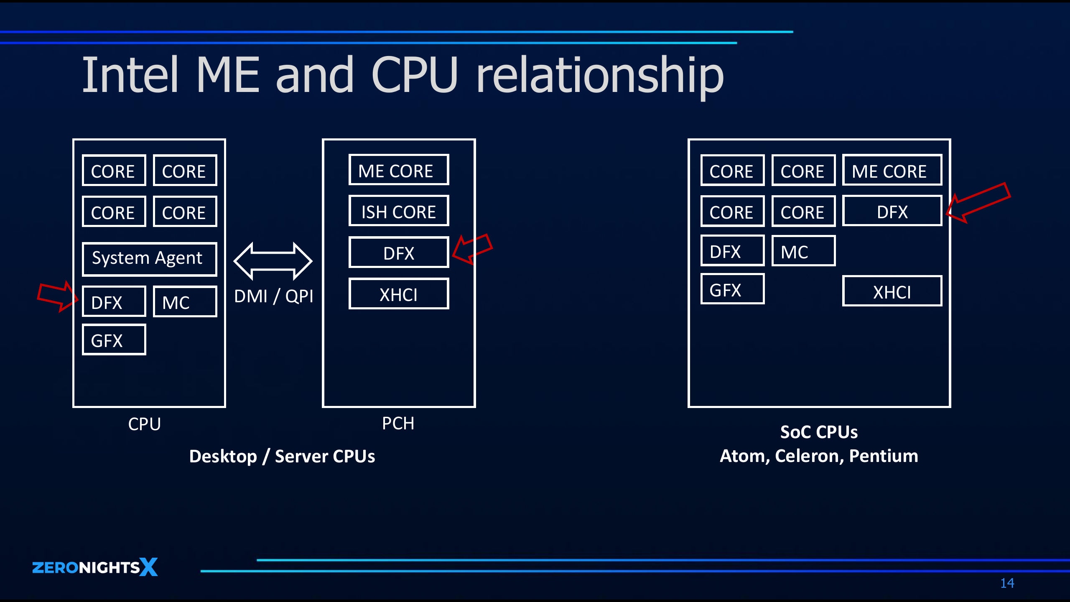
Why Goldmont only
"How We Achieved to Execute Arbitrary Ucode"

Slide 58
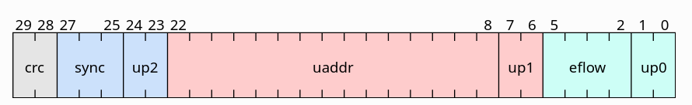
Why microcode update is a lost cause
We don’t have the RC4 key
RC4 vulnerable to bit flips
But each uinstr/seqword has a CRC
From lib-micro docs

